Slide 1
Addressing the 200,000 Housing Unit Shortfall in Harris County Texas NCDA Annual Conference
June 22 – 24, 2022, St. Paul MN.

Slide 2
Background
10-year County housing strategy: response to 2017 Hurricane Harvey. CDBG-DR planning and CDBG-CV funded $2.8M. Led by Community Services Dept. (HUD Urban County) and consulting team from Rice University – Kinder Institute. Housing Policy Advisory Committee formed by Harris County Commissioners Court. Presented to Commissioners Court on Nov 9, 2021.
Sets stage for a 10-Yr. Housing Plan for County. Precedents include Seattle/King Co., Austin, Atlanta, Dallas, Nashville, San Antonio. Data & GIS analysis driving housing investment strategy for $210M ARPA Treasury Housing Portfolio.
The 1,800 sq. mi. county includes 34 cities, incld. Houston. Unincorporated area is apprx. 2.5M pop. and would be 5th largest city in the U.S. No ordinance ability, cannot issue GO Debt for housing. Powers derived from state constitution.

Slide 4
Why this Matters

Slide 5
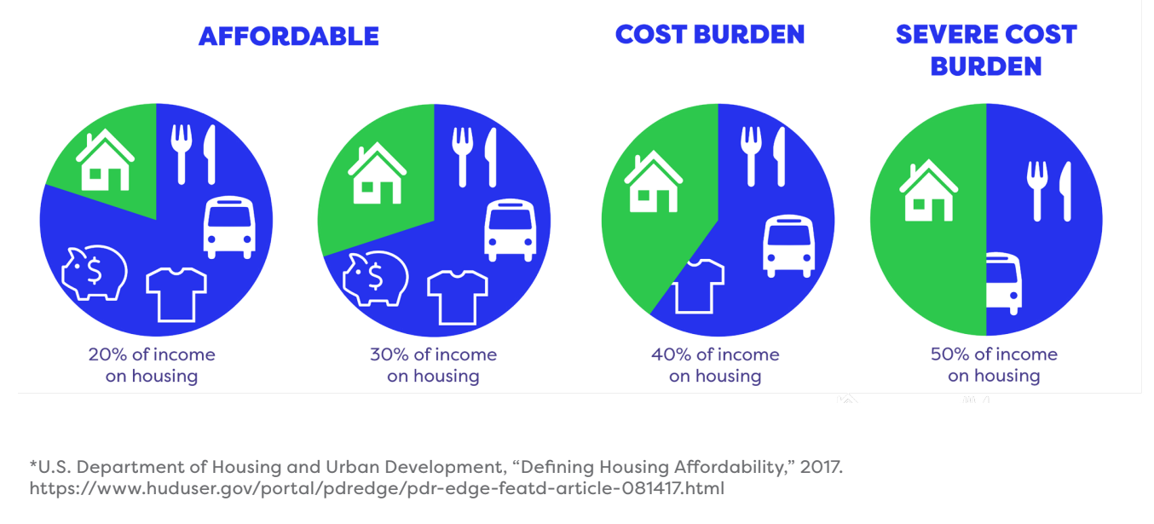
Why This Study Matters – The Affordability Challenge
Almost 500,000 households in Harris County have difficulty affording to live in their homes today (pay over 30% income for housing).

Slide 6
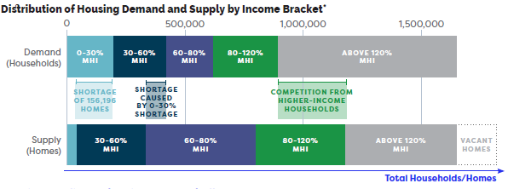
Why are so many people cost-burdened?
Lack of homes available to extremely low-income households.

Slide 7
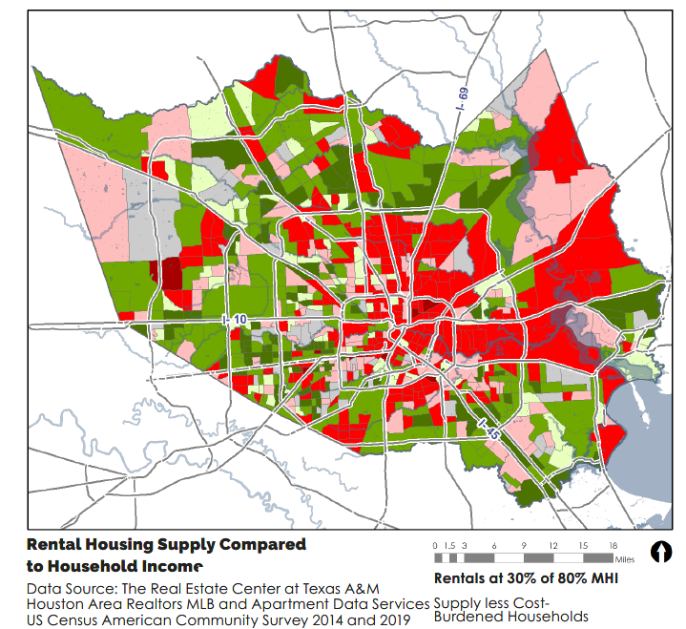
Location Challenges –Spatial Mismatch
Green areas have more affordable rental homes than number of cost-burdened renters, meaning it exceeds demand. Red areas have more cost-burdened renter households than the number of affordable units. Green areas tend to be located in places where cars are required to access jobs and services.

Slide 8
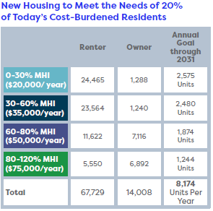
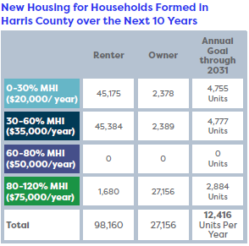
How many homes are needed to alleviate today’s need and plan for new households?

Slide 9
What We Heard

Slide 10
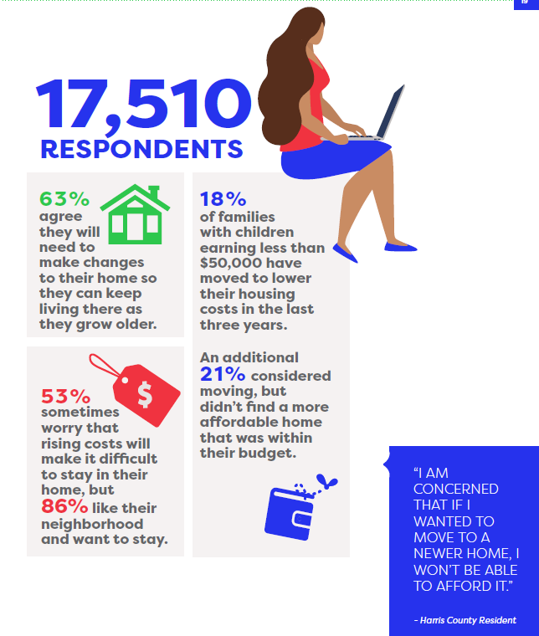
What We’ve Heard
Dignified housing means more than just four walls—residents want resilient and livable neighborhoods.

Slide 11
What is our Strategy

Slide 12
Value #1
INVEST IN HOUSING FOR ALL through preservation, new construction, and infrastructure investments that support communities.
Goal 1: Increase the supply of safe, high-quality rental and for-sale housing for low-moderate income households.
Goal 2: Incentivize a mixture of housing types.
Goal 3: Preserve and build affordable infill housing options.
Goal 4: Ensure that infrastructure improvements are available to support the production of affordable housing.

Slide 13
Value #2
COLLABORATE WITH PARTNERS to foster a comprehensive, affordable housing system.
Goal 5: Create mixed income housing communities and mixed-use housing developments where there is access to jobs, transportation, services, and amenities.
Goal 6: Attract investment that enhances economic opportunity.
Goal 7: Diversify housing types and expand transportation choices.

Slide 14
Value #3
ADVANCE EQUITY AND RESILIENCE in all County housing efforts.
Goal 8: Aim for inclusion and promote fair housing to undo the legacy of racial and economic segregation.
Goal 9: Adapt to hazards and support sustainable neighborhood development.

Slide 15
Value #4
ADVOCATE FOR HOUSING POLICY REFORMS at all levels of government.
Goal 10: Identify federal and state level reforms.
Goal 11: Identify local reforms with municipalities and special-purpose districts to support the development of affordable housing.

Slide 16
Adrienne Holloway, Ph.D. Executive Director, Harris County Community Services Department, Adrienne.Holloway@csd.hctx.net
Rene Martinez, Chief Housing & Community Development, HCCSD
Rene.Martinez@csd.hctx.net
https://csd.harriscountytx.gov/Pages/default.aspx

